Slide 1
2Facebook or not 2Facebook in Education: that’s the question?
Teaching and Learning on Facebook
Valère Awouters, Dries Palmaers, Andy Veltjen

Slide 2
Do you use a social network, like e.g. Facebook, …?

Slide 3
Number of years to reach 50 million users
Radio → 38 years
TV 13 years
Internet → 4 years
iPod → 3 years
Facebook had 100 million users in 9 months

Slide 4
Do you use internet daily?

Slide 5
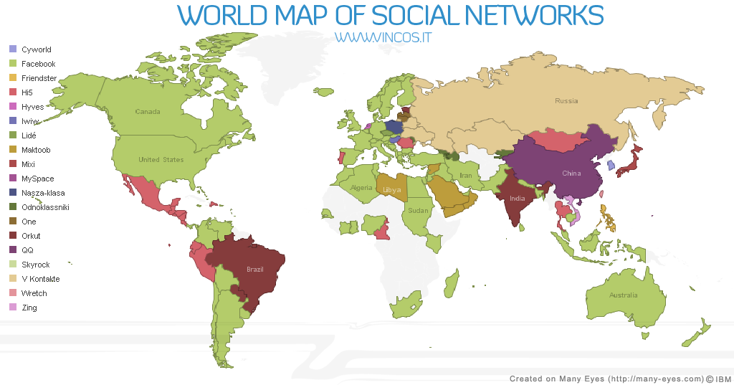

Slide 6
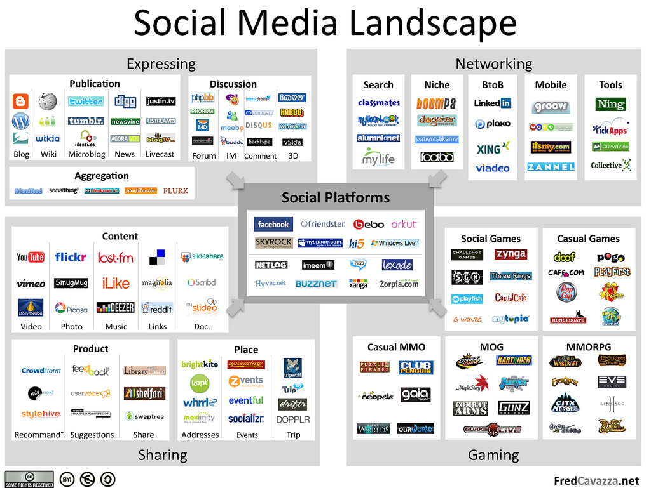

Slide 7
21st Century Skills for teachers

Slide 8
Do you know the 21st century skills for teachers?

Slide 9
Formal and Informal Learning
http://www.addthis.com/

Slide 10
Do you use facebook (or other social networks) for teaching and learning?

Slide 11

Ethics
Can teachers be friends with pupils on facebook?
What is allowed?
How to deal with mis-behaviour?

Slide 12
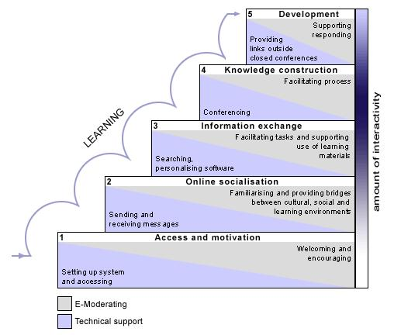
Facebook in Education

Slide 13
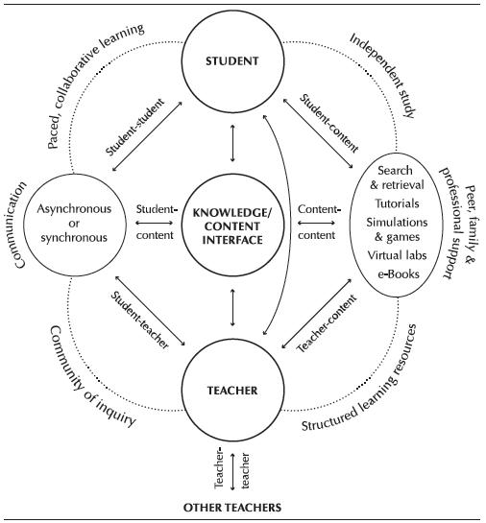
Teaching for the 21st century

Slide 14



Social Media in your schools?
3 pros and cons?

