Slide 1
“That’s me”, e-pal project
Goran Stojanovic (gstojanovic@vmboharderwijk.nl)
Spela Grum (spela.drmota@gmail.com)

Slide 2
A collaborative project between two classes in Slovenia and the Netherlands.
“That’s me”, e-pal project
Main aims:
This project is going to encourage and support our target group to use the Internet and the ICT- learning environment.
Pupils are going to learn to present and express themselves in a creative and innovative way.
a
alineja 3
alineja 4
  alineja 4.1
  alineja 4.2
alineja 5

Slide 3
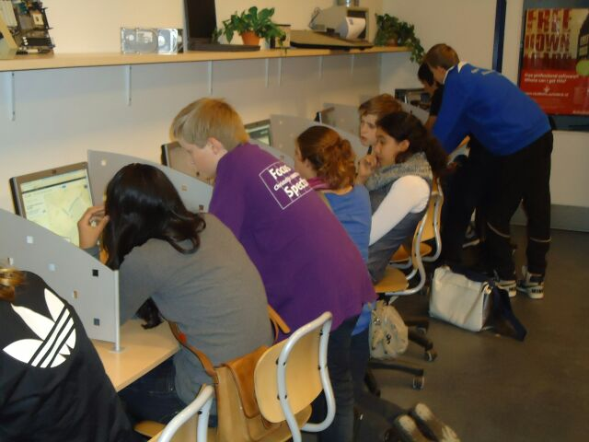
Naslov prosojnice
Pupils during an open ICT - lesson at Spectrum.
alineja 1
alineja 2
alineja 3
alineja 4
  alineja 4.1
  alineja 4.2
alineja 5

Slide 4
1st phase:
“That’s me”, e-pal project
Getting to know each other.
ŠCL, Srednja lesarska šola
(Špela Grum)
Chr. VMBO – Harderwijk
(Goran Stojanović)
Visit of the Slovenian delegation during my English lessons…

Slide 5
How did we get started?
“That’s me”, e-pal project
Mood-board
Bubble
Pen-friends project
The idea behind: we want our pupils to be able to present themselves, their family, hobbies and ambitions. Firstly, by expressing themselves through images and later on through writing and speaking.

Slide 6
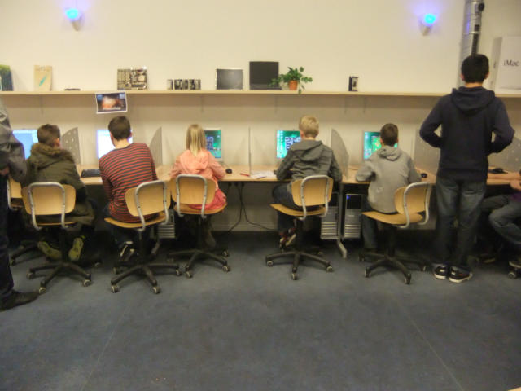
Naslov prosojnice
The pupils learn about internet…
alineja 1
alineja 2
alineja 3
alineja 4
  alineja 4.1
  alineja 4.2
alineja 5

Slide 7
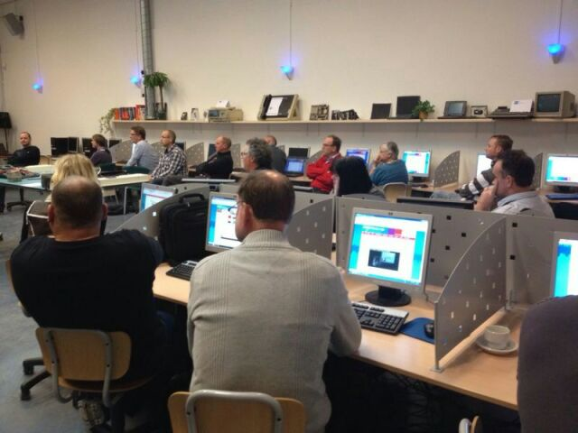
Naslov prosojnice
The teachers are learning as well.
alineja 1
alineja 2
alineja 3
alineja 4
  alineja 4.1
  alineja 4.2
alineja 5

Slide 8
2nd phase:
“That’s me”, e-pal project
Creating their own original Mood-board.
Creative and innovative step.
Making mind maps.
Producing a detailed lesson plan for teachers.
Interaction with the Slovenian group.

Slide 9
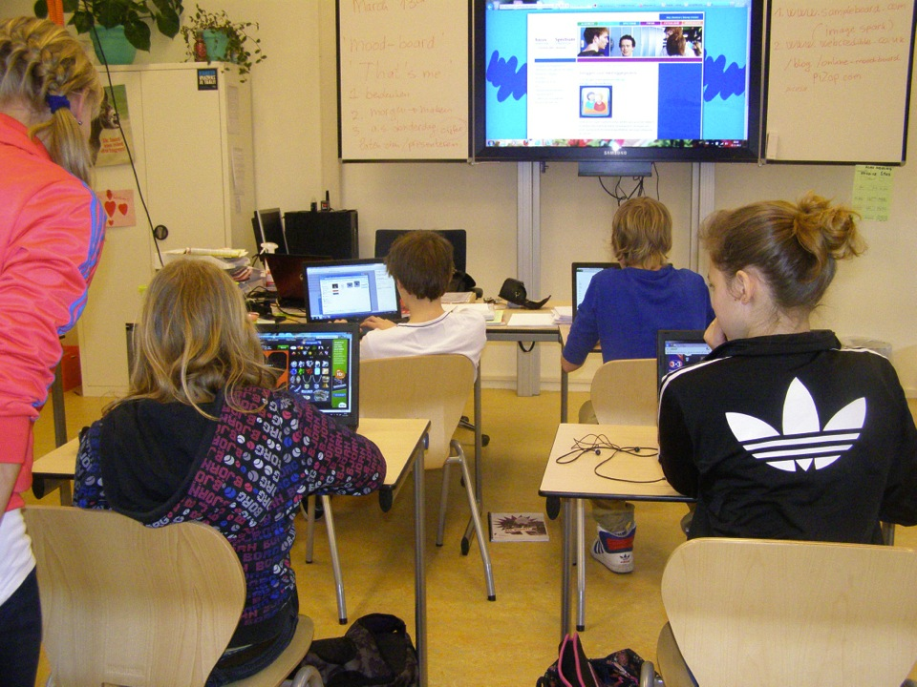
Naslov prosojnice
alineja 1
alineja 2
alineja 3
alineja 4
  alineja 4.1
  alineja 4.2
alineja 5

Slide 10
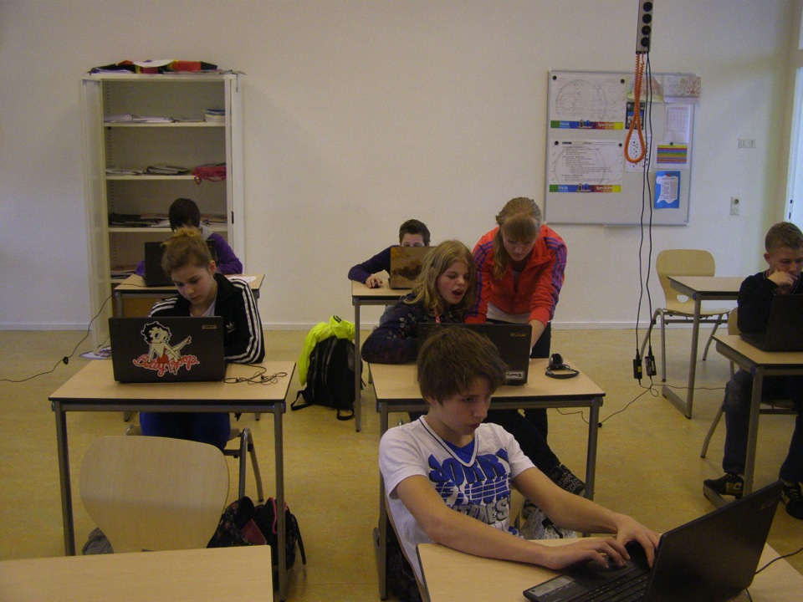
Naslov prosojnice
alineja 1
alineja 2
alineja 3
alineja 4
  alineja 4.1
  alineja 4.2
alineja 5

Slide 11
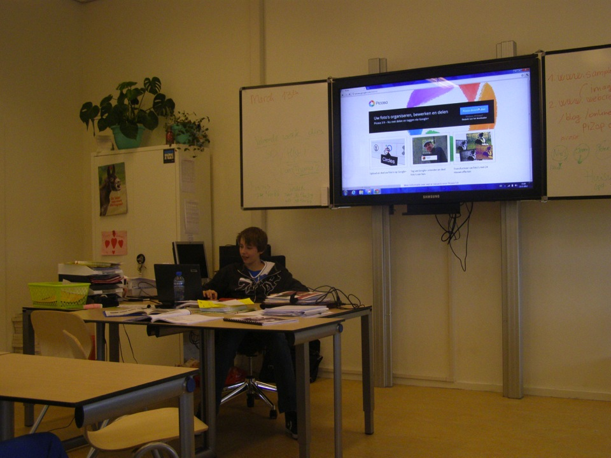
Naslov prosojnice
alineja 1
alineja 2
alineja 3
alineja 4
  alineja 4.1
  alineja 4.2
alineja 5

Slide 12
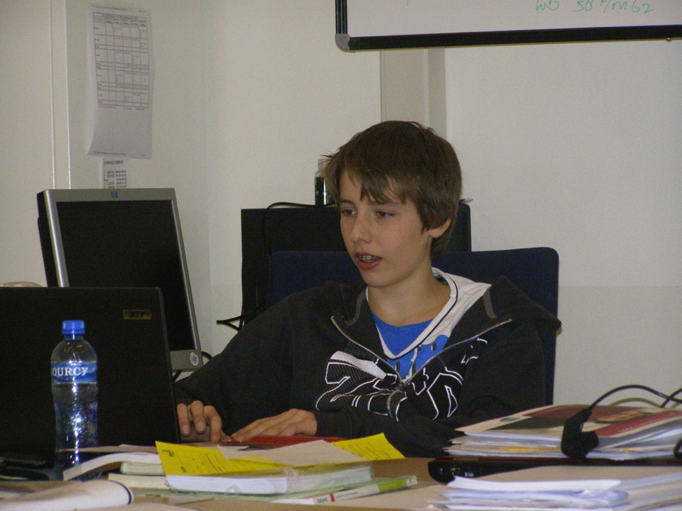
Naslov prosojnice
alineja 1
alineja 2
alineja 3
alineja 4
  alineja 4.1
  alineja 4.2
alineja 5

Slide 13
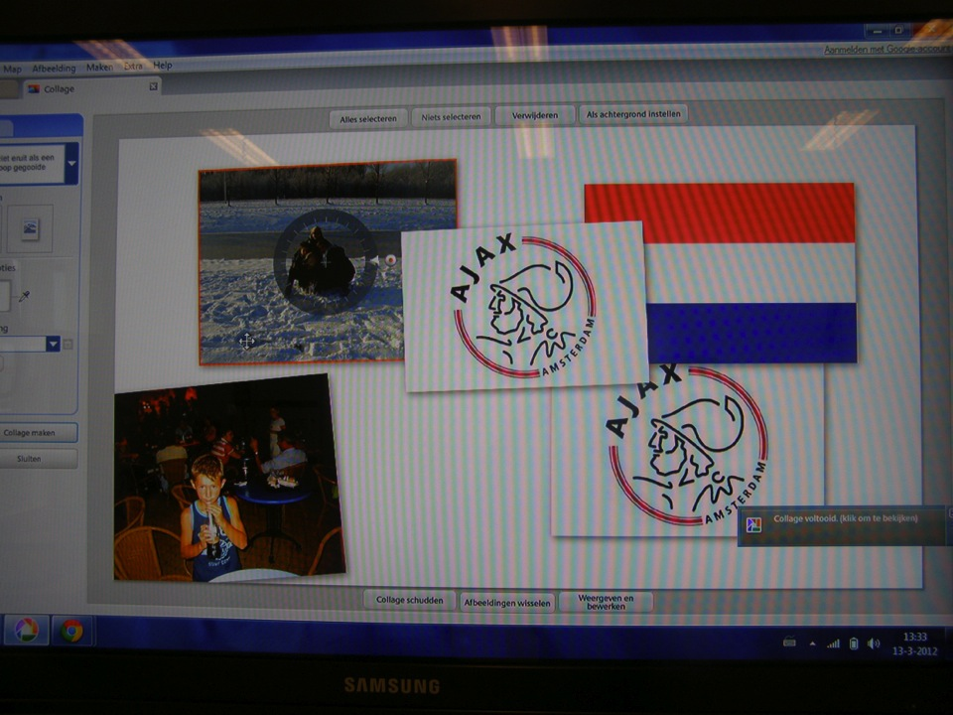
Naslov prosojnice
alineja 1
alineja 2
alineja 3
alineja 4
  alineja 4.1
  alineja 4.2
alineja 5

Slide 14
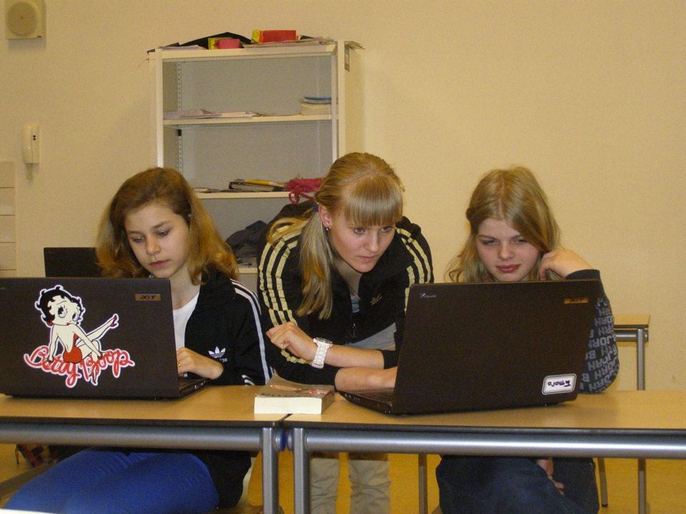
Naslov prosojnice
alineja 1
alineja 2
alineja 3
alineja 4
  alineja 4.1
  alineja 4.2
alineja 5

Slide 15
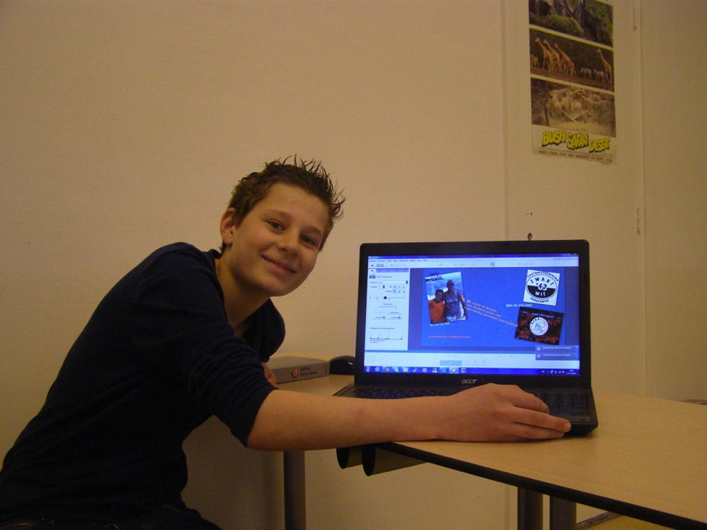
Naslov prosojnice
alineja 1
alineja 2
alineja 3
alineja 4
  alineja 4.1
  alineja 4.2
alineja 5

Slide 16
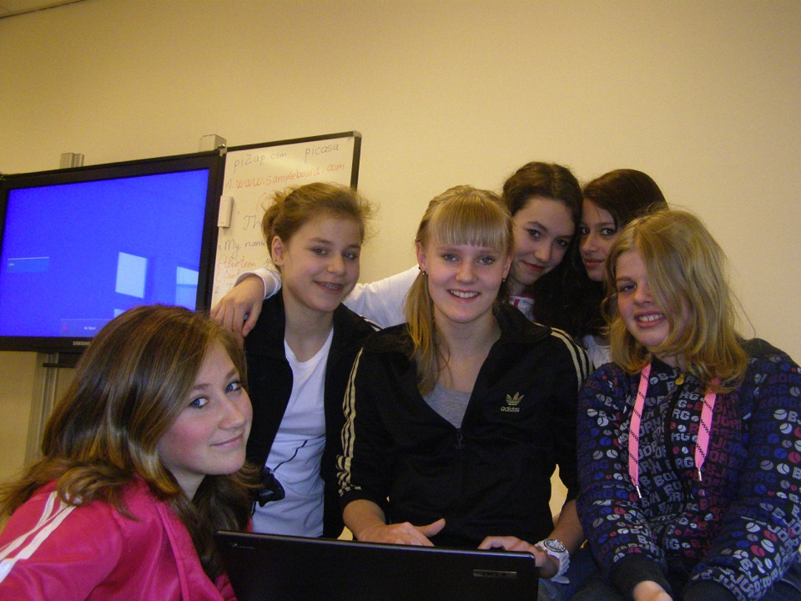
Naslov prosojnice
alineja 1
alineja 2
alineja 3
alineja 4
  alineja 4.1
  alineja 4.2
alineja 5

Slide 17
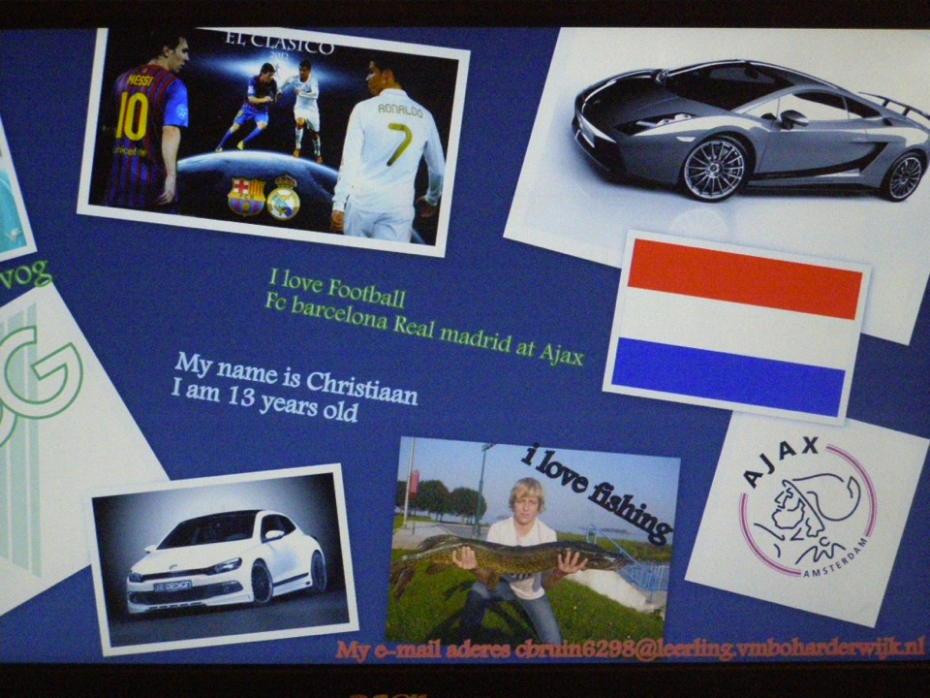
Naslov prosojnice
alineja 1
alineja 2
alineja 3
alineja 4
  alineja 4.1
  alineja 4.2
alineja 5

Slide 18
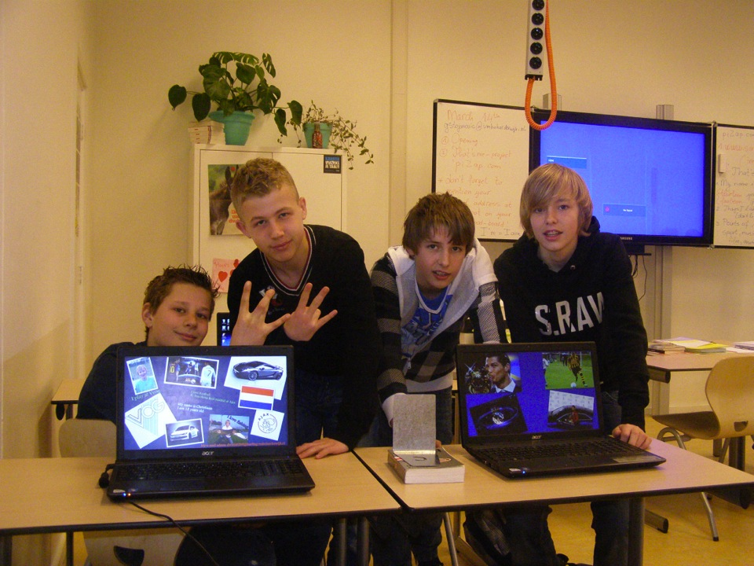
Naslov prosojnice
alineja 1
alineja 2
alineja 3
alineja 4
  alineja 4.1
  alineja 4.2
alineja 5

Slide 19
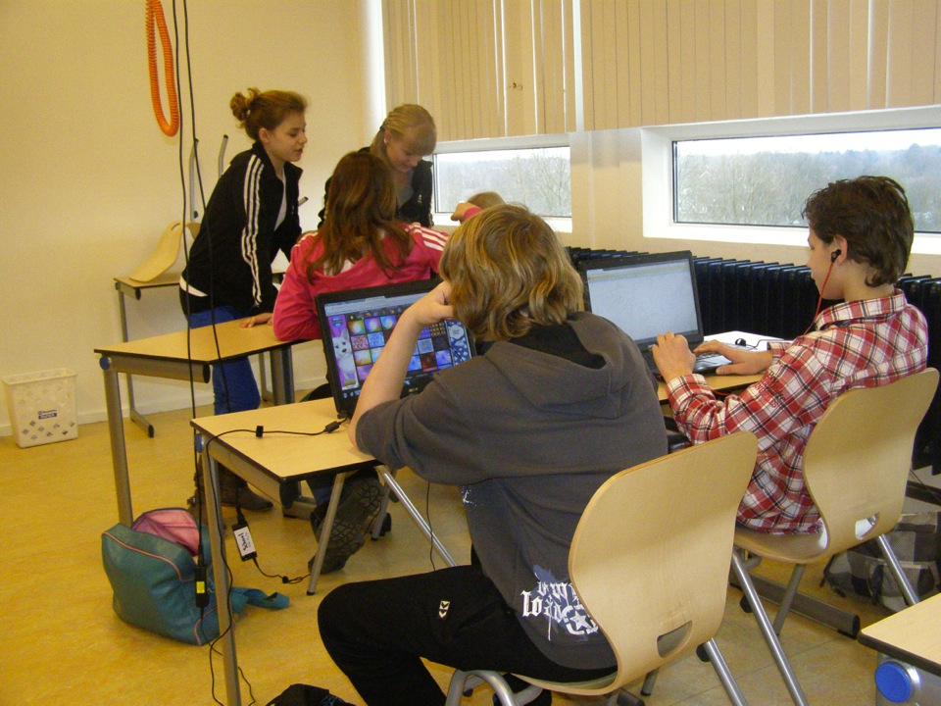
Naslov prosojnice
alineja 1
alineja 2
alineja 3
alineja 4
  alineja 4.1
  alineja 4.2
alineja 5

Slide 20
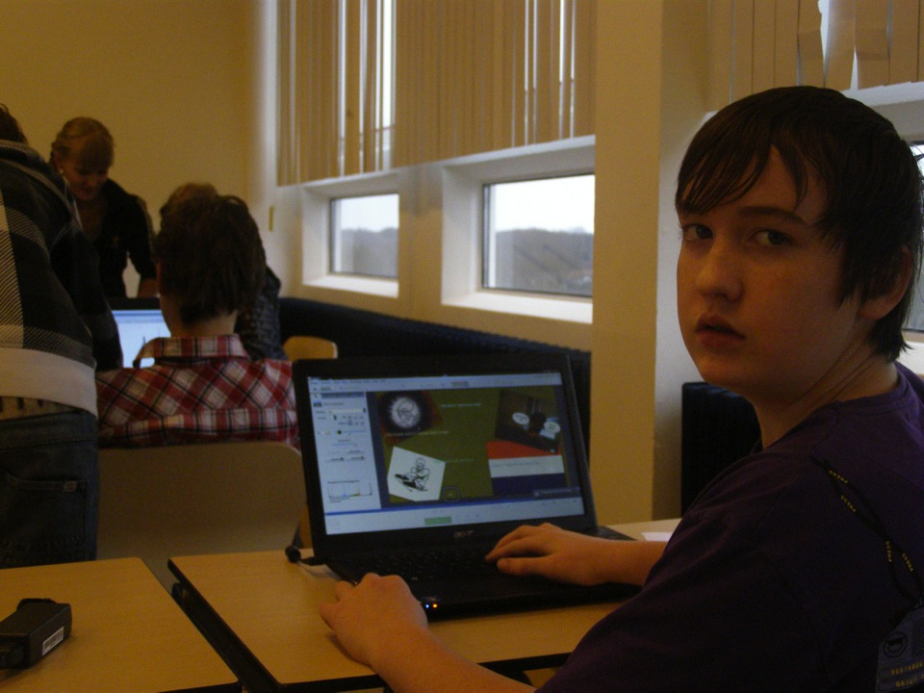
Naslov prosojnice
alineja 1
alineja 2
alineja 3
alineja 4
  alineja 4.1
  alineja 4.2
alineja 5

Slide 21
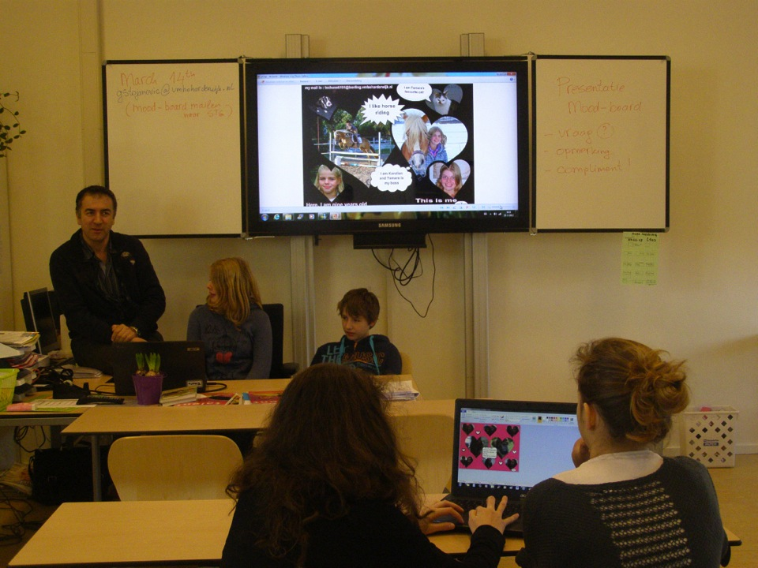
Naslov prosojnice
alineja 1
alineja 2
alineja 3
alineja 4
  alineja 4.1
  alineja 4.2
alineja 5

Slide 22
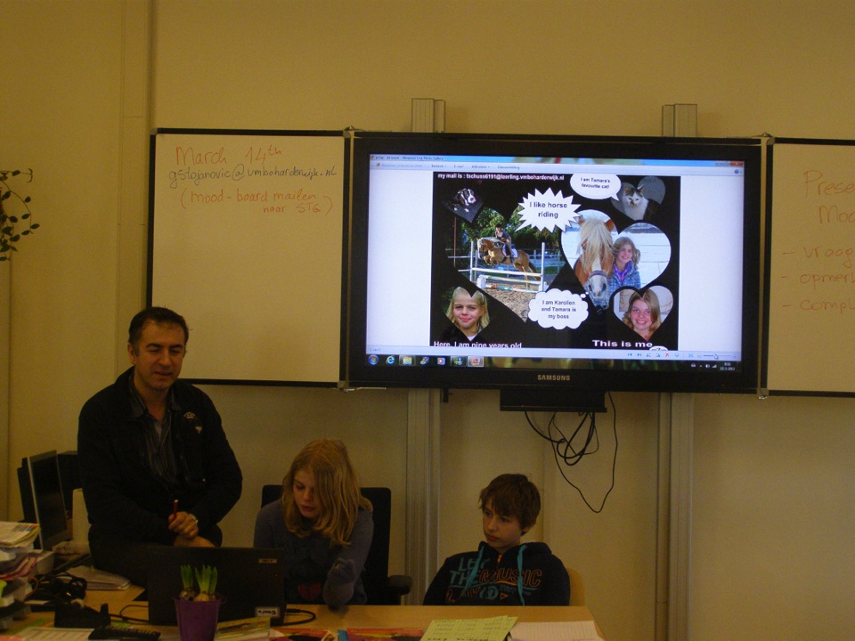
Naslov prosojnice
alineja 1
alineja 2
alineja 3
alineja 4
  alineja 4.1
  alineja 4.2
alineja 5

Slide 23
3rd phase:
“That’s me”, e-pal project
Evaluation of the project.
Detailed lesson plan which can be reused by other foreign language teachers.

Slide 24
What next?
“That’s me”, e-pal project
Continuation:
We will develop and bring this project to another level by adding writing or speaking elements to it.
- Possibly another class?
International aspects:
Technical – cultural – historical – economical - collaboration

