Slide 1
The Impact of personality characteristics on behaviour in the workplace
Ian Wigston
Managing Consultant-Education
Glowinkowski International

Slide 2
Why this presentation is in English

Slide 3
Outline
Icebreaker
Some context
Predispositions and Behaviour
Problem Solving and Implementation
Communication and Interpersonal Style
Feelings and Self Control
Learning Style
A little magic!
Climate in the workplace

Slide 4
Please take a moment to consider the following. In each box try and think of at least two examples. We will be discussing this as part of the workshop later today.
Things I enjoy and am good at:
Things I enjoy but am not good at:
Things I don’t enjoy but am good at:
Things I don’t enjoy and am not good at:

Slide 5
Please take a moment to consider the following. In each box try and think of at least two examples. We will be discussing this as part of the workshop later today.
Things I enjoy and am good at:
Meeting new people and networking
Golf
Things I enjoy but am not good at:
Playing the guitar
Singing
Things I don’t enjoy but am good at:
Keeping track of money
Tidying my office
Things I don’t enjoy and am not good at:
Swimming
Washing up dishes

Slide 6
Glowinkowski™ Integrated Framework
Strategic
Objectives

Slide 7
Glowinkowski™ Integrated Framework
Strategic
Objectives
Critical
Critical
Critical
Success
Success
Success
Factors
Factors
Factors

Slide 8
Glowinkowski™ Integrated Framework
Strategic
Objectives
Critical
Critical
Critical
Success
Success
Success
Factors
Factors
Factors
Predispositions
and Motivations

Slide 9
Glowinkowski™ Integrated Framework
Strategic
Objectives
Critical
Critical
Critical
Success
Success
Success
Factors
Factors
Factors
Predispositions
and Motivations
Organisational
Leadership
[Group]
Structure
Behaviours
Processes

Slide 10
Glowinkowski™ Integrated Framework
Strategic
Objectives
Critical
Critical
Critical
Success
Success
Success
Factors
Factors
Factors
Predispositions
and Motivations
Organisational
Leadership
[Group]
Structure
Behaviours
Processes
Climate

Slide 11
Glowinkowski™ Integrated Framework
Strategic
Objectives
Critical
Critical
Critical
Success
Success
Success
Factors
Factors
Factors
Predispositions
and Motivations
Organisational
Leadership
[Group]
Structure
Behaviours
Processes
Climate
Performance

Slide 12

Kurt Lewin’s Equation
B = ƒ (P x S)
Actual behaviour is a function of Personality (Predisposition) and Situation
© 2012 Glowinkowski™ International Limited

Slide 13
Who do you think you are?
Glowinkowski Predisposition Indicator

Slide 14
Problem Solving & Implementation Style
© 2010 Glowinkowski™ International Limited

Slide 15
Problem Solving & Implementation Style
Incremental
Radical
© 2010 Glowinkowski™ International Limited

Slide 16
Problem Solving & Implementation Style
Incremental
Radical
© 2010 Glowinkowski™ International Limited

Slide 17
Problem Solving & Implementation Style
The Thinking Dimension
Incremental
Radical
Prefers change to be in small incremental steps
Is mainly interested in improving existing ways of doing things
Prefers to look at a situation in detail
Considers practical application more important than theory
Prefers to deal with hard facts
Prefers to evaluate all the available data before making a decision
Prefers the more Radical solutions to problems
Prefers to find different ways of doing things
Enjoys seeing the bigger picture
Enjoys thinking about how different ideas inter-relate
Puts imagination before information when problem-solving
Prefers to use intuition in order to solve problems
© 2010 Glowinkowski™ International Limited

Slide 18
Problem Solving & Implementation Style
Focused
Incremental
Radical
Flexible
© 2010 Glowinkowski™ International Limited

Slide 19
Problem Solving & Implementation Style
The Achieving Dimension
Focused
Tends to be single minded in pursuit of an outcome
Prefers to work with deadlines
Prefers work that requires attention to accuracy and detail
Prefers to have a clearly defined objective in mind
Is highly organised in how they carry out their activities
Prefers their activities to be prioritised
Finds it easy to move on to something new
Enjoys seeing the value of new approaches
Sometimes feels that detailed preparation can inhibit effectiveness
Prefers keeping their options open
Prefers less structure and organisation applied to their activities
Tends not to prioritise their activities
Flexible
© 2010 Glowinkowski™ International Limited

Slide 20
Problem Solving & Implementation Style
Focused
PLANNER
STRATEGIST
Incremental
Radical
PRACTITIONER
VISIONARY
Flexible
© 2010 Glowinkowski™ International Limited

Slide 21

Problem Solving and Implementation Style
Planner
Generate practical and realistic ideas
Are well organised and create plans with clear priorities
Can be resistant to change
Prefer gradual improvement and realistic ideas for change
Like to have several different practical tasks on the go at once
Many find themselves with too much on the go at once
Like to put structure around large scale, complex problems
Comfortable making considerable changes to what already exists
Can be uninterested in day to day nuts and bolts issues
Look at the bigger picture and future possibilities that exist
Create radically different ideas that represent tangible change
Less interested by the practicalities of turning ideas into reality
Practitioner
Strategist
Visionary
© 2011 Glowinkowski™ International Limited

Slide 22
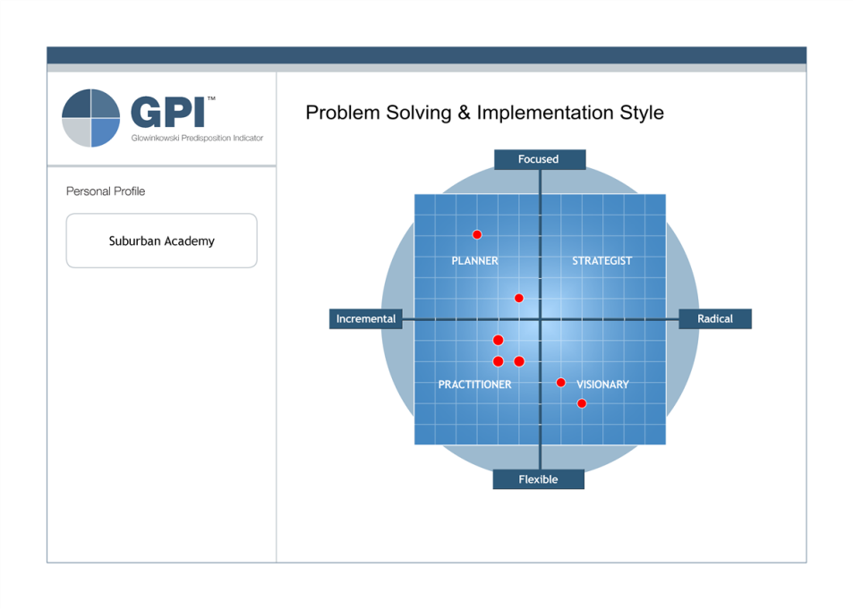
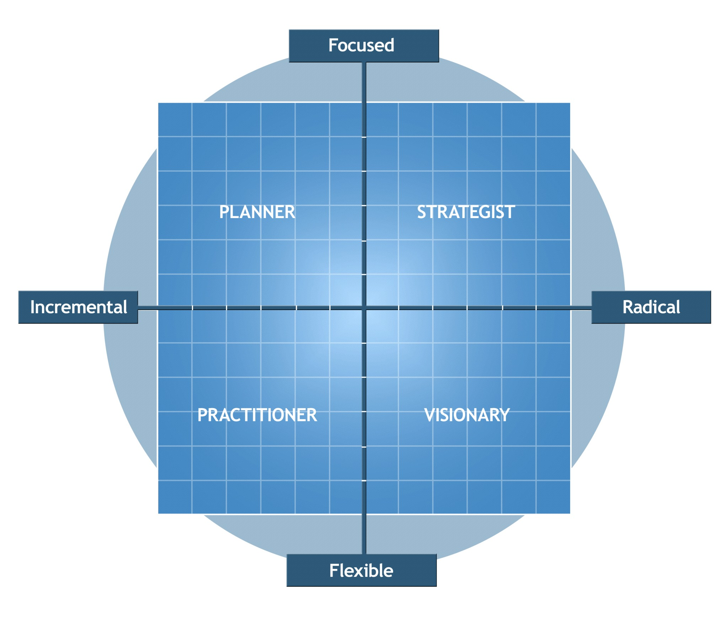
M Bennison

Slide 23
Problem Solving & Implementation Style
The Thinking Dimension
Incremental
Radical
The way we generate ideas and relate to change and problem-solving
1
Evolutionary
Revolutionary
Smaller steps, controlled improvements, existing practices, well-regulated
Bigger shifts, bigger picture, different approaches
The way we like to assimilate new information
2
Practical
Conceptual
Clearly connected ideas, maps/models, today’s problems
Disconnected ideas, lack of coherence, tomorrow’s problems
The way information is used for decision making
3
Rational
Intuitive
Hard facts, logic-based, evidence, evaluated data
Insight, imagination, less data, “gut-feel”
© 2010 Glowinkowski™ International Limited

Slide 24
Problem Solving & Implementation Style
The Achieving Dimension
Focused
4
Outcome
5
Conscientious
6
Perfectionist
Outcome focused, persistent, repeated effort to get result, more interested in outcome
Ties up loose ends, works to deadlines, accuracy and detail, clearly defined goals
Personal standards of excellence, impatient with errors, satisfaction with detail
The degree of thoroughness in our approach
Our standards and how much we are prepared to vary them
The style of task delivery
Flexible approach, changes direction, values new approaches, enjoys the journey
Accuracy not that important, keeps options open, not full attention to one thing
80/20, fit for purpose, prepared to cut corners in order to deliver
Flexible
Spontaneous
Cursory
Pragmatist
© 2010 Glowinkowski™ International Limited

Slide 25
Communication & Interpersonal Style
© 2010 Glowinkowski™ International Limited

Slide 26
Communication & Interpersonal Style
Extraversion
Introversion
© 2010 Glowinkowski™ International Limited

Slide 27
Communication & Interpersonal Style
Extraversion
Introversion
© 2010 Glowinkowski™ International Limited

Slide 28
Communication & Interpersonal Style
Collectivist
Extraversion
Introversion
Individualist
© 2010 Glowinkowski™ International Limited

Slide 29
Communication & Inter-personal Style
The Extraversion Dimension
Extraversion
Introversion
Enjoys the company of others
Prefers to talk problems through
Enjoys large social gatherings
Considers having a good time as a priority
Feels comfortable in social situations
Feels comfortable when meeting new people
Enjoys own company
Prefers to think through a problem before stating an opinion
Finds it easy to be on their own
Is serious minded
Tends to feel ill at ease in new and large social situations
Prefers to mix with people they know
© 2010 Glowinkowski™ International Limited

Slide 30
Communication & Inter-personal Style
The Agreeableness Dimension
Collectivist
Prefers to avoid saying hurtful things to others
Is concerned about the needs of people that they know
Finds it easy to trust people
Would prefer to co-operate than compete
Finds it easy to conform
Tends to be discreet about their accomplishments
Is not concerned about personal popularity
Prefers to deal with the task to be done rather than people
Tends to be cautious when dealing with others
Finds it easy to take an opposing view
Asks tough probing questions
Assumes that their views will be found acceptable
Individualist
© 2010 Glowinkowski™ International Limited

Slide 31
Communication & Interpersonal Style
Collectivist
ENCOURAGER
SUPPORTER
Extraversion
Introversion
CHALLENGER
INDEPENDENT
Individualist
© 2010 Glowinkowski™ International Limited

Slide 32
Communication & Interpersonal Style
Challenger
Open, assertive, prepared to debate and challenge others’ views
Focused on achieving their own agenda, but reasonable on compromising to achieve group goals
Rational, reserved, possibly detached, comfortable pursuing own interests
Keep views to themselves but possess good insight to group issues
Speak when necessary and comfortable expressing opposing view
Sociable, outgoing, helpful
Creates good atmosphere through sympathetic response
Natural tendency to be uncomfortable dealing with conflict, hold back from tackling difficult situations
Unassuming, considerate, trusting
Focused on achieving group goals
Can appear unfriendly at first, but are good listeners and offer rather than impose solutions
Independent
Encourager
Supporter
© 2010 Glowinkowski™ International Limited

Slide 33

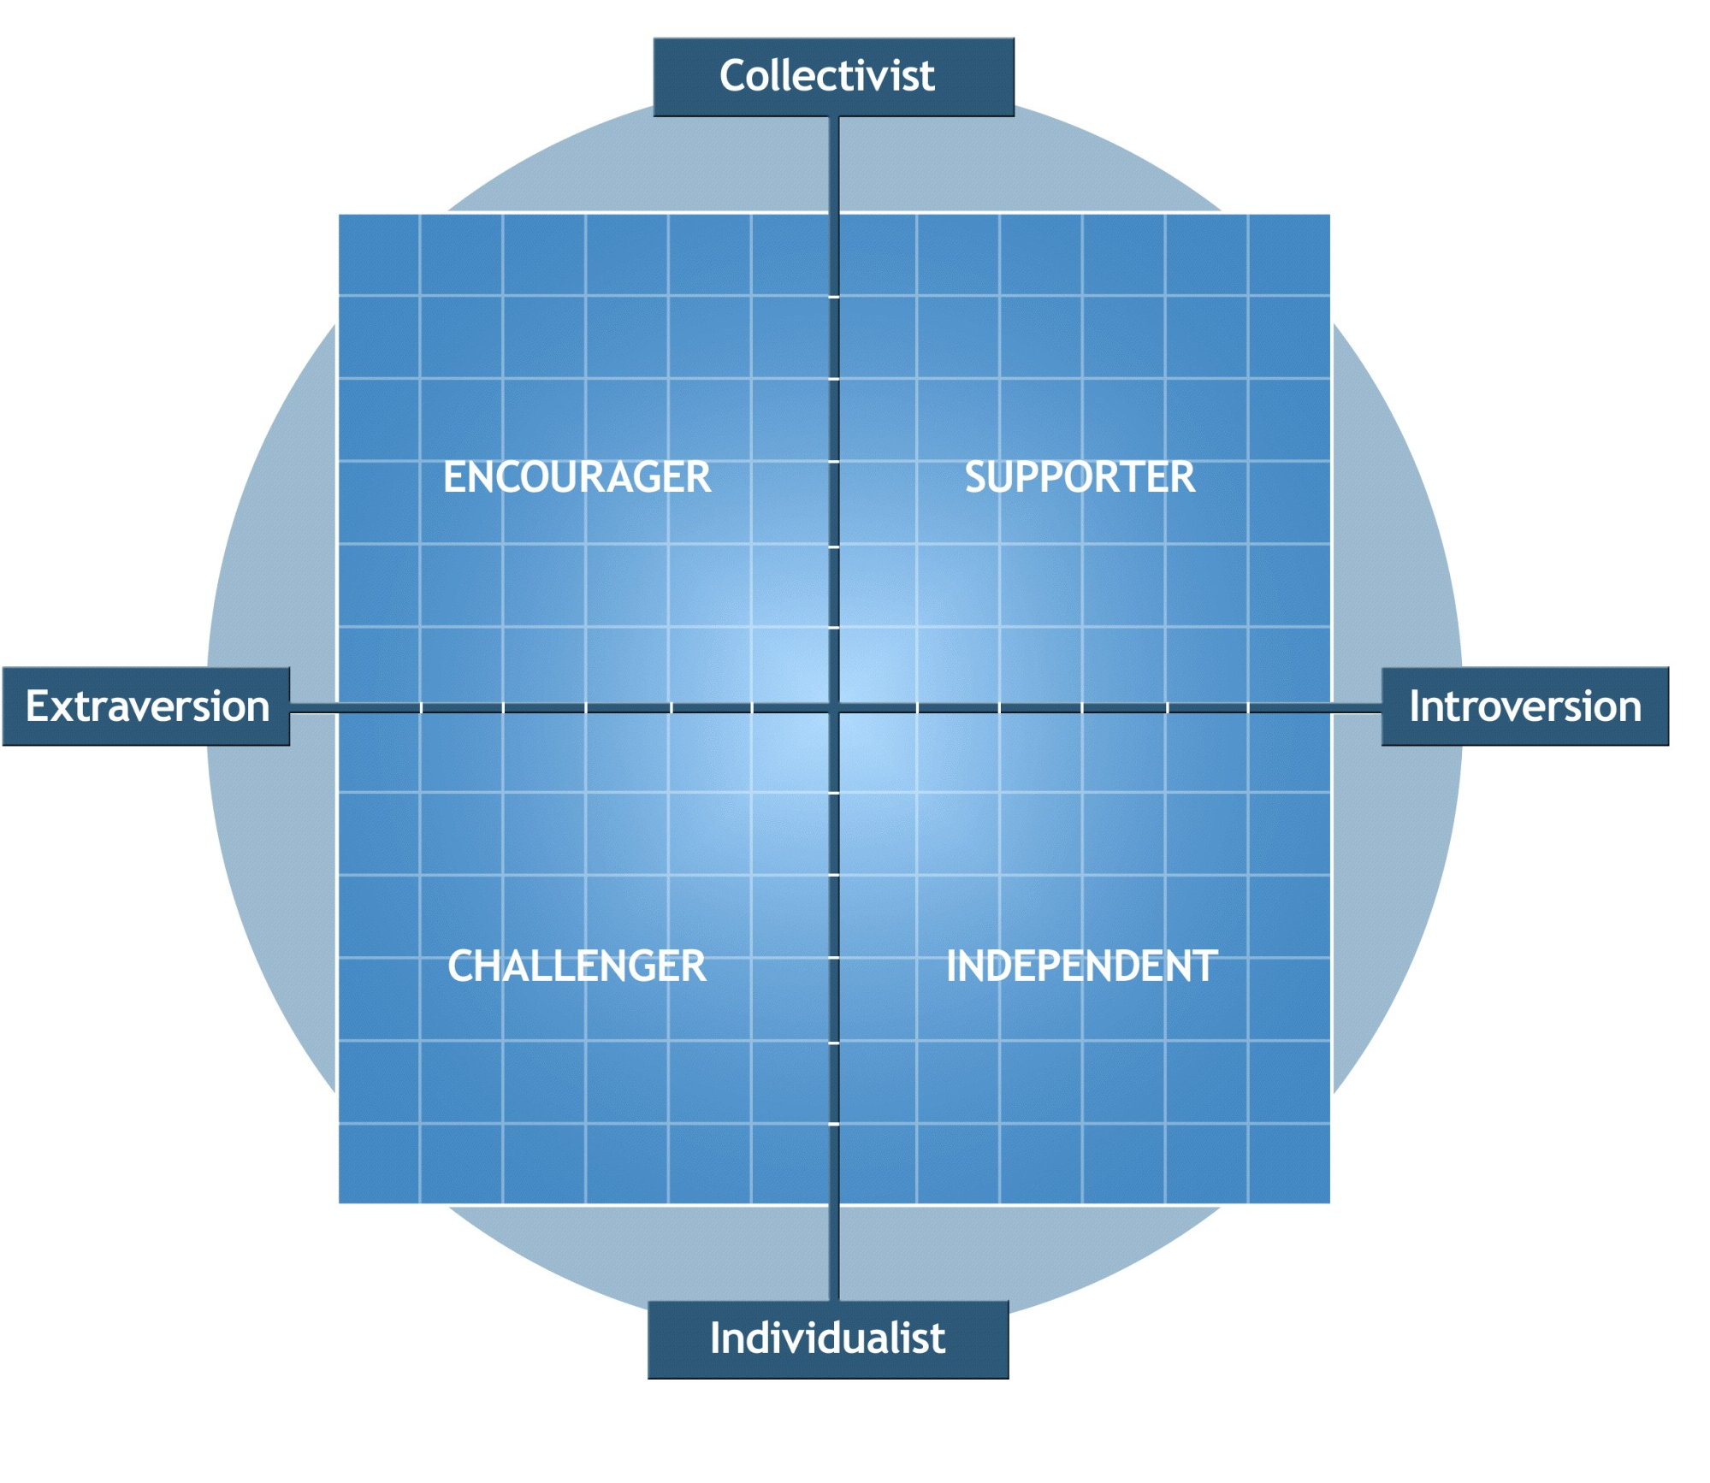
M Bennison

Slide 34
Communication & Inter-personal Style
The Extraversion-Intraversion Dimension
Extraversion
Introversion
1
Outgoing
Reserved
The way social engagements affect individuals and energises them
Enjoys company of other people, draws from their energy, happy to talk things through
Enjoys own thinking and ideas, less energised by social scene, happy to work on own
2
Asserting
Accepting
The way we interact with others
Can be socially ascendant, forceful, speak without hesitation, can speak mind
Happy to keep thoughts to themselves, hesitant to speak mind, could be submissive
3
Fun-loving
Serious-minded
The way we’re orientated towards life and pleasure-seeking
Dominated by pleasure-seeking, pursuit of pleasure (in both work and play)
Dominated by sense of duty, life is a serious endeavour not to be trifled with
4
Socially assured
Socially uncertain
The individual’s tendency to feel comfortable within the broader social context
Comfortable in social situations, comfortable meeting new people
More hesitant in social situations, less comfortable meeting new people
© 2010 Glowinkowski™ International Limited

Slide 35
Communication & Inter-personal Style
The Agreeableness Dimension
Collectivist
5
Affiliative
6
Trusting
7
Conforming
8
Modest
Likes to be liked, concerned with conflict and confrontation, personal relationships key
Takes people at face value, people are essentially honest
Tends to co-operate not compete, fits in, prefers to comply
Discreet about achievements, hides light under a bushel, gets on with it
The significance of personal relationships
Our views on people’s motives
The tendency to challenge/comply in a group
How an individual sees themselves in relation to others
Less concerned with popularity, more task orientated
Cautious, cynical, people are essentially dishonest
Tends to disagree, easy to take opposing view, asks tough questions, devil’s advocate
Enjoys talking about achievements, likes praise, can be demanding
Individualist
Unaffiliative
Questioning
Dissenting
Assuming
© 2010 Glowinkowski™ International Limited

Slide 36
A little magic!

Slide 37
Feelings & Self-Control
© 2010 Glowinkowski™ International Limited

Slide 38
Feelings & Self-Control
At-Ease
Ill-at-Ease
© 2010 Glowinkowski™ International Limited

Slide 39
Feelings & Self-Control
At-Ease
Ill-at-Ease
© 2010 Glowinkowski™ International Limited

Slide 40
Feelings & Self-Control
Disciplined
At-Ease
Ill-at-Ease
Impulsive
© 2010 Glowinkowski™ International Limited

Slide 41
Feelings & Self-Control
Disciplined
COMPOSED
CONTAINED
At-Ease
Ill-at-Ease
ENERGISED
EXPRESSIVE
Impulsive
© 2010 Glowinkowski™ International Limited

Slide 42
Feelings & Self-Control
Disciplined
COMPOSED
CONTAINED
At-Ease
Ill-at-Ease
ENERGISED
EXPRESSIVE
Impulsive
© 2010 Glowinkowski™ International Limited

Slide 43
Feelings & self-control
The Emotionality Dimension
At-Ease
Ill-at-Ease
Feels Relaxed
Feels positive and contented with their life experience
Tends to look at the future optimistically
Experiences positive self esteem
Tends to feel tense and stress orientated
Discontented and feels a degree of anger in relation to past experience
Tends to look at the future pessimistically
Experiences low self esteem
© 2010 Glowinkowski™ International Limited

Slide 44
Feelings & Self control
The Impulsiveness Dimension
Disciplined
Tends to manage urges more effectively, no need for instant gratification, can hold their tongue – “think before speak”
Our predisposition to “controlling” our urges
Less able to manage urges effectively, could be frustrated, “speak before think”
Impulsive
© 2010 Glowinkowski™ International Limited

Slide 45
Feelings & self-control
The Emotionality Dimension
At-Ease
Ill-at-Ease
1
Relaxed
Tense
The predisposition to worry and get apprehensive
Lower levels of anxiety, not dwell on things, less apprehensive
Tendency to worry and dwell on things that have gone wrong, apprehensive
2
Placid
Discontented
The tendency to get frustrated, or angry, in relation to difficulties
Takes a relaxed view, “c’est la vie”, laid back
Tendency to get frustrated, even discontent and possibly bitter
3
Optimistic
Pessimistic
The tendency to view things in a positive or negative light
Greater confidence in future, excited by future and possibilities, tend not to be too discouraged
More negative view, not sure of role in future or what it means, concerned
4
Self-confident
Self-conscious
The way we value ourselves, irrespective of the view of others
Have good self-worth, hold good self-image, confident, not so self-critical
Less self-worth, lower value and belief in self, self critical, “hard on oneself”
© 2010 Glowinkowski™ International Limited

Slide 46
Learning Style & Environment
Outgoing
(Active)
DOING
(Workshop)
DISCUSSING
(Seminar)
Practical
(Practical)
Conceptual
(Theoretical)
TESTING
(Laboratory)
READING
(Theoretical)
Reserved
(Reflective)
© 2010 Glowinkowski™ International Limited

Slide 47
Creativity & Entrepreneurship
Internalise
Accepting
Pessimistic
Disciplined
Considered trial of improvement to the existing
A measured approach to communicating change
Developing
Transforming
Evolutionary
Conforming
Conscientious
Revolutionary
Dissenting
Cursory
Enthusiastic promotion of adaptations to a theme
Rigorous pursuit of ground-breaking
ideas
Asserting
Optimistic
Impulsive
Externalise
Influencing orientation
Low
Medium
High
© 2010 Glowinkowski™ International Limited

Slide 48
SUMMARY TABLE OF CLIMATE FRAMEWORK
DIMENSIONS | SUB-SCALES | ESSENCE STATEMENT
CLARITY | Long-term direction Integration Co-ordination | Well established long term direction People’s/Groups activities are well integrated Making progress toward long term direction
CHALLENGE | Innovation Achievement | Encouraged to try new approaches Stretched with goals that are challenging/realistic
CHANGE ORIENTATION | Motivation Adaptability Flexibility | Take action before being directed Minimum of unnecessary procedures A readiness/enthusiasm for change
AUTONOMY | Independence Accountability Effort | Does not always have to check/ask permission A feeling that the individual can make a difference Prepared to work beyond job remit
RECOGNITION | Reward Feedback Value & Appreciation | Differential relation between reward and performance Receiving effective feedback Feeling of being valued and appreciated
INVOLVEMENT | Commitment Trust Synergy | Committed to the teams long-term direction Proud to be part of the team Whole is greater than the sum of parts
©2012 Glowinkowski™ International Limited

